Slide 1

Docker Security in Google Cloud
Phạm Hồng Khánh

Slide 2
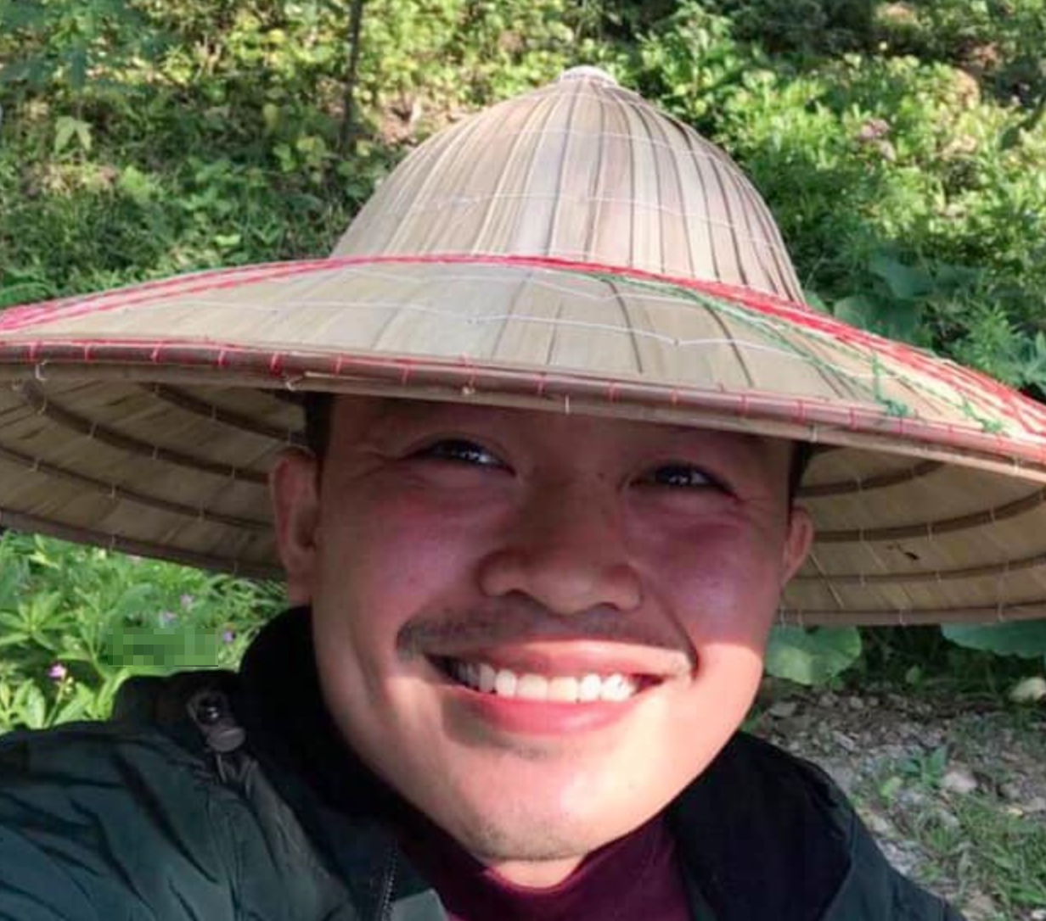
whoami
Security Engineer at mgm security partners
5 years IP Networking
3 years Infrastructure Operations
Phạm Hồng Khánh
khanh.hong.pham@mgm-sp.com

Slide 3
Application
https://github.com/khanhhongpham/google-io-danang

Slide 4
Application in Google Cloud
Application

Slide 5



Docker Attack Surfaces
HOST
RESOURCES
REGISTRY
CONTAINERS
IMAGES

Slide 6
Docker Image Security

Slide 7
Docker Image Security
Key Messages
Use offical base images
Continuously scan images

Slide 8
Docker Attack Surfaces
HOST
RESOURCES
REGISTRY
CONTAINERS
IMAGES

Slide 9
A secure Docker Registry – Options?
Private
Cheap, under your control
You have to think about everything yourself!
Hosted
More features
Privacy! Costs!
REGISTRY

Slide 10
Docker Attack Surfaces
HOST
RESOURCES
REGISTRY
CONTAINERS
IMAGES

Slide 11
Docker Host Security
HOST
Docker is only as secure as the underlying host!
Options
Kubernetes
Compute Engine
Cloud Run
App Engine

Slide 12
Docker Attack Surfaces
HOST
RESOURCES
REGISTRY
CONTAINERS
IMAGES

Slide 13
Docker Container Security
Secure defaults
But can be more robust
CONTAINERS

Slide 14
Docker Container Security
Privileged Container

Slide 15
Docker Container Security
Key Messages
Least privilege for containers
Do not use --privileged
Docker runs as root by default docker run --user 1001 <img>
Use security policies
Seccomp (default profile)
AppArmour, SELinux
Limit container resources
docker run -it --memory=2G --cpus=1 ubuntu bash

Slide 17
Application Security
Key Messages
Security knowledge
Penetration Tests
Automated scanners in CI/CD
References
https://www.owasp.org/index.php/XSS_(Cross_Site_Scripting)_Prevention_Cheat_Sheet

Slide 18
Google Cloud Web Security Scanner

Slide 19
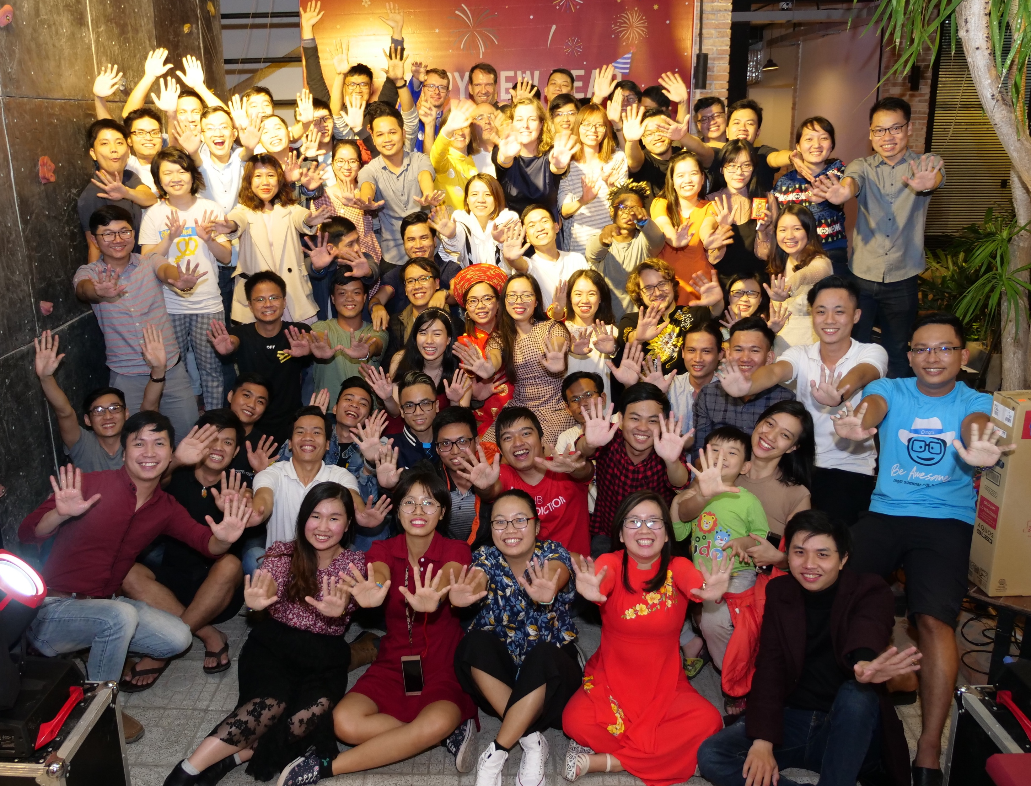


~100 employees in Đà Nẵng since January 2016
Notes:
Opened the first office in the Da Nang in 2016 and second office in end of 2017
Over 100 employees in the Da Nang
Working internatinally/ Colleagues travelling to Europe and the other way around
(A lot of extracurricular activities: climbing, running & marathon, BBQ on the rooftop, summer trip to Phong Nha etc.)

Slide 20
Application

Slide 21
Thank you! Questions?

Slide 22


Innovation Implemented.
München
Aachen
Bamberg
Berlin
Đà Nẵng
Dresden
Grenoble
Hamburg
Köln
Leipzig
Nürnberg
Prag
Stuttgart
Washington
Zug
mgm technology partners Vietnam
07 Pasteur & 7 Phan Chau Trinh
Đà Nẵng, Vietnam
Tel.: +84 (236) 3531 773
www.mgm-tp.com

